Slide 1
Introduction to mobile APP development
Teacher: Dr. XU Linlin

Slide 2
Content
Introduction to Andriod based mobile APP development.
Mobile APP development process.
Introduction to Andriod Studio .
Introduction to Android Studio layout and components.
Course projects .
Task.

Slide 3


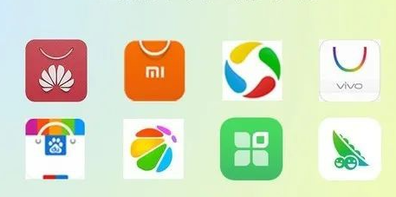
1.Introduction to Andriod based mobile APP development
Comparence of market share between Android and iOS.
≈ 2 : 1
VS
Main iOS application market
Main Android application market

Slide 4
1.Introduction to Andriod based mobile APP development
Android is an operating system developed by Google, based on Linux platform and mainly aimed at mobile terminals;
Now, the development tool of Android is Android studio, and the development language is Java;
The APP development based on Android studio is the native Android mobile application development;

Slide 5
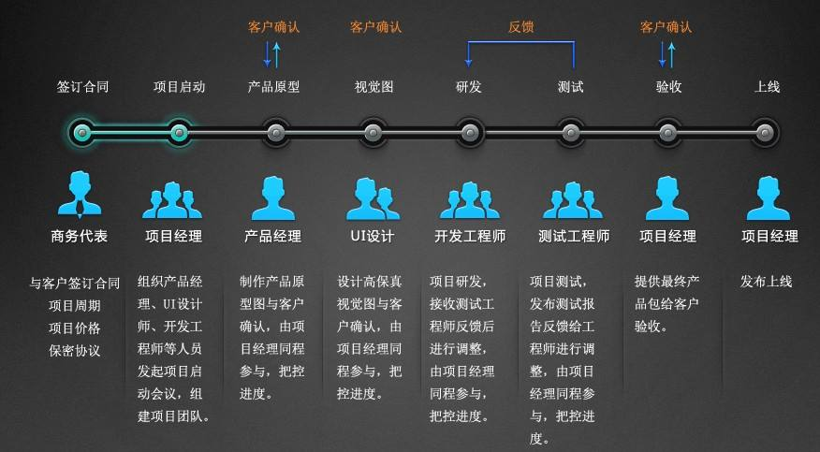
2. Mobile APP development process

Slide 6
2. Mobile APP development process
Demand analysis
Prototype design
UI Design
App development
Project testing
Release
Operation iteration
Routine maintenance

Slide 7
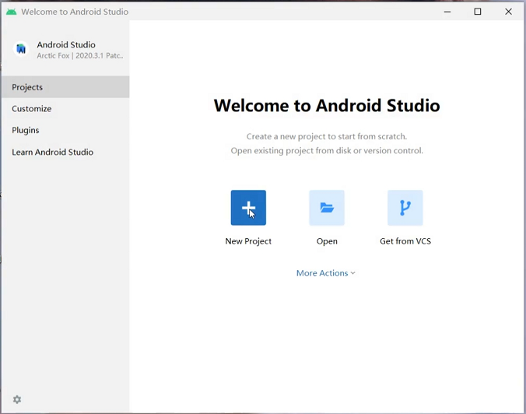
3. Introduction to Andriod Studio software
1) You will get the following window after you click the Android studio icon on the desktop of your PC for the first time.
Click New Project

Slide 8
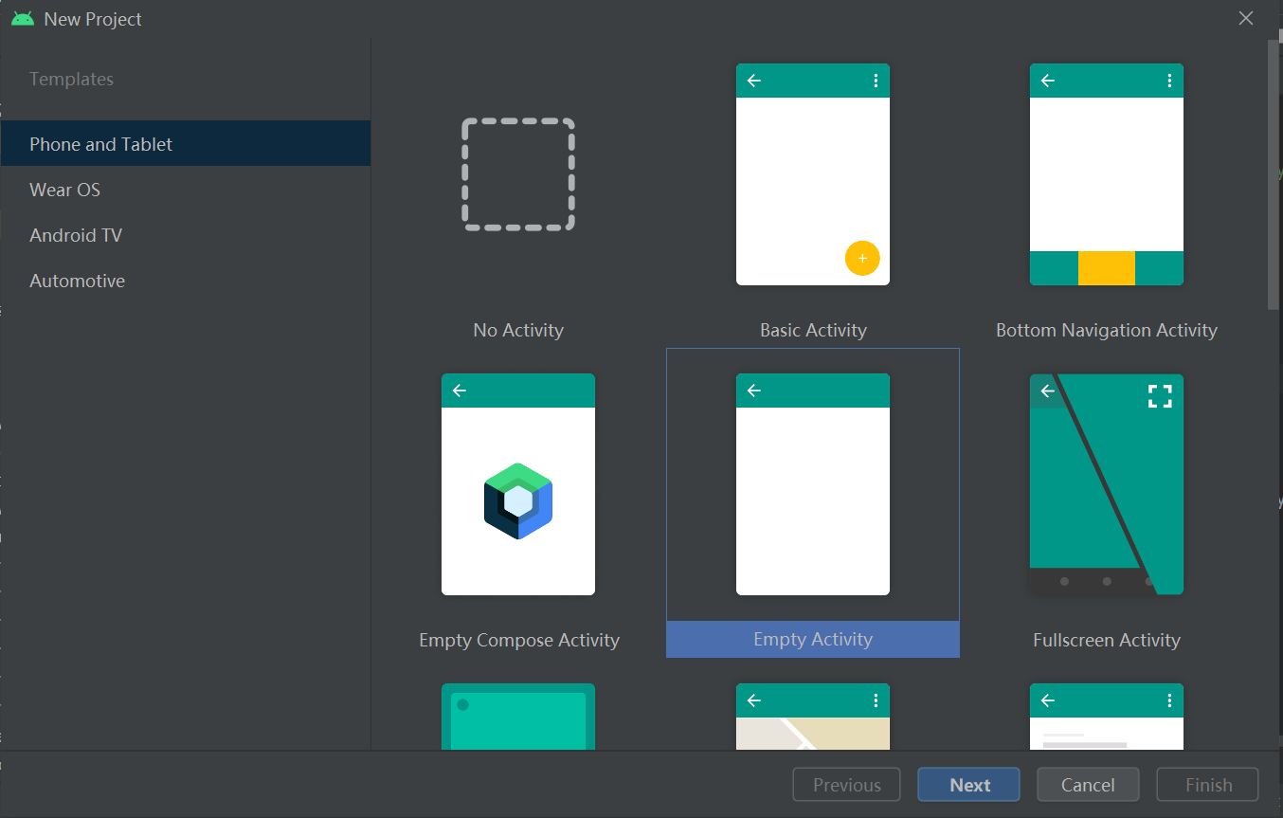
2) Please select Phone and Tablet and Empty Activity.

Slide 9
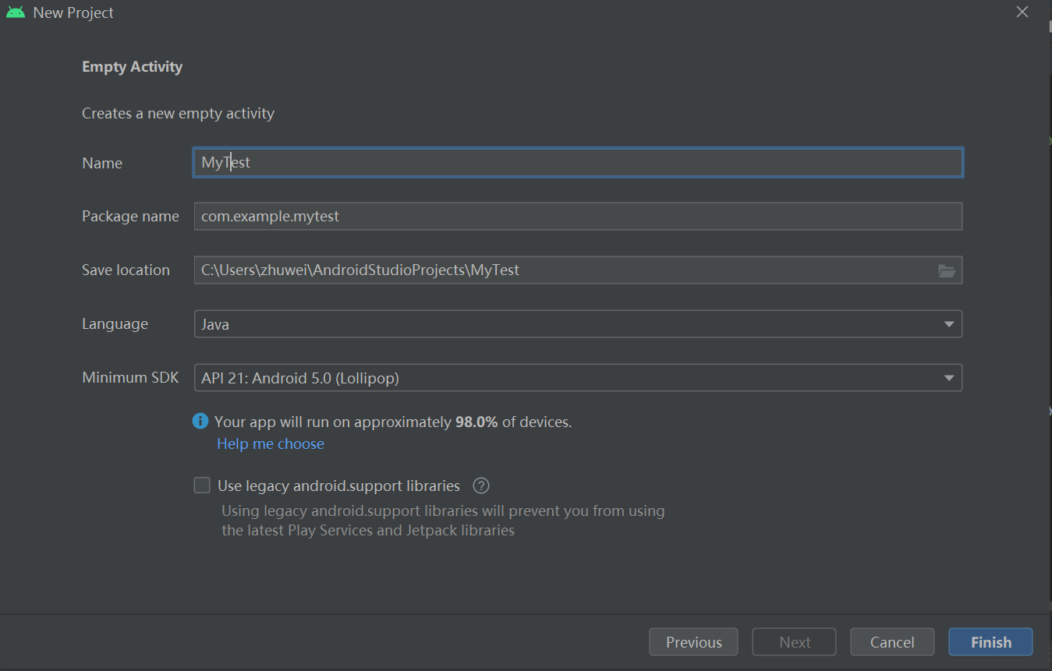
3) You will get the following window after you click Phone and Tablet and Empty Activity.
Enter a project name you like and easy to recognize the APP
Enter a package name that is unique.
You select (at least 10G space left in chosen disk).
Select Java.
Select default.
At last, click Finish.

Slide 10
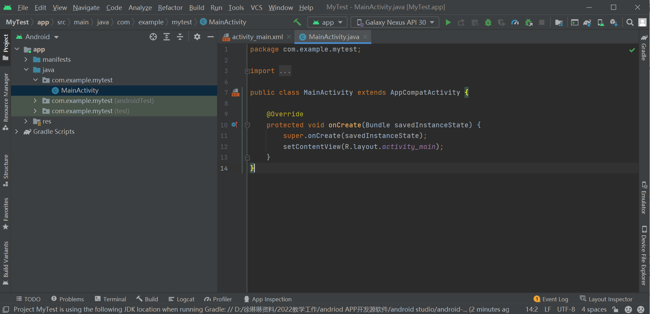
4) . After finish 3),you will get the following Android Studio interface window.
Layout window
Code window

Slide 11
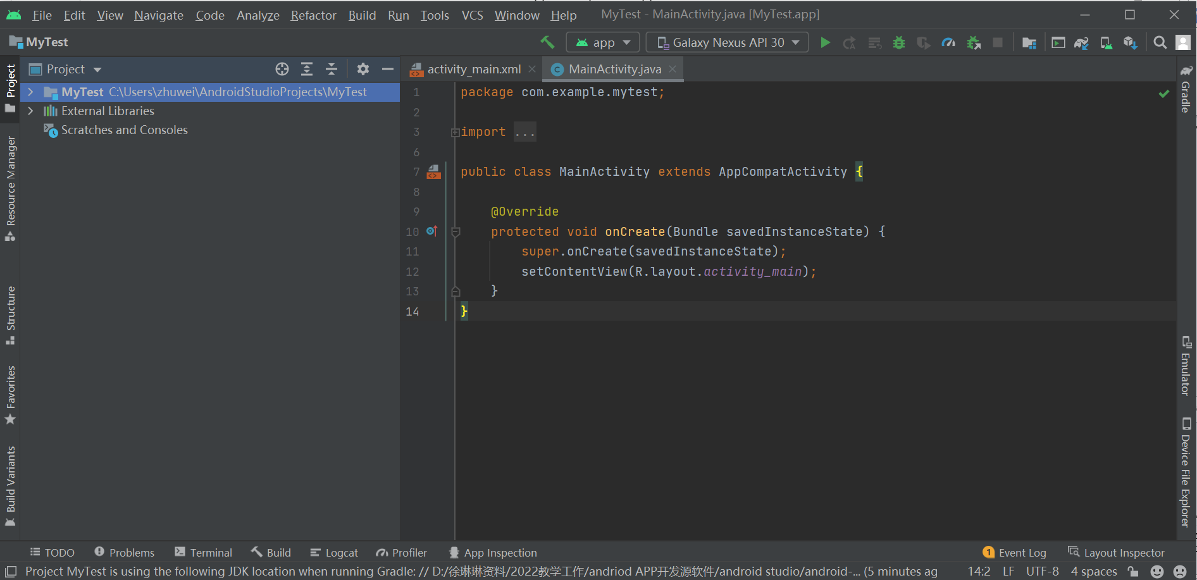
5) . Change to Project view

Slide 12
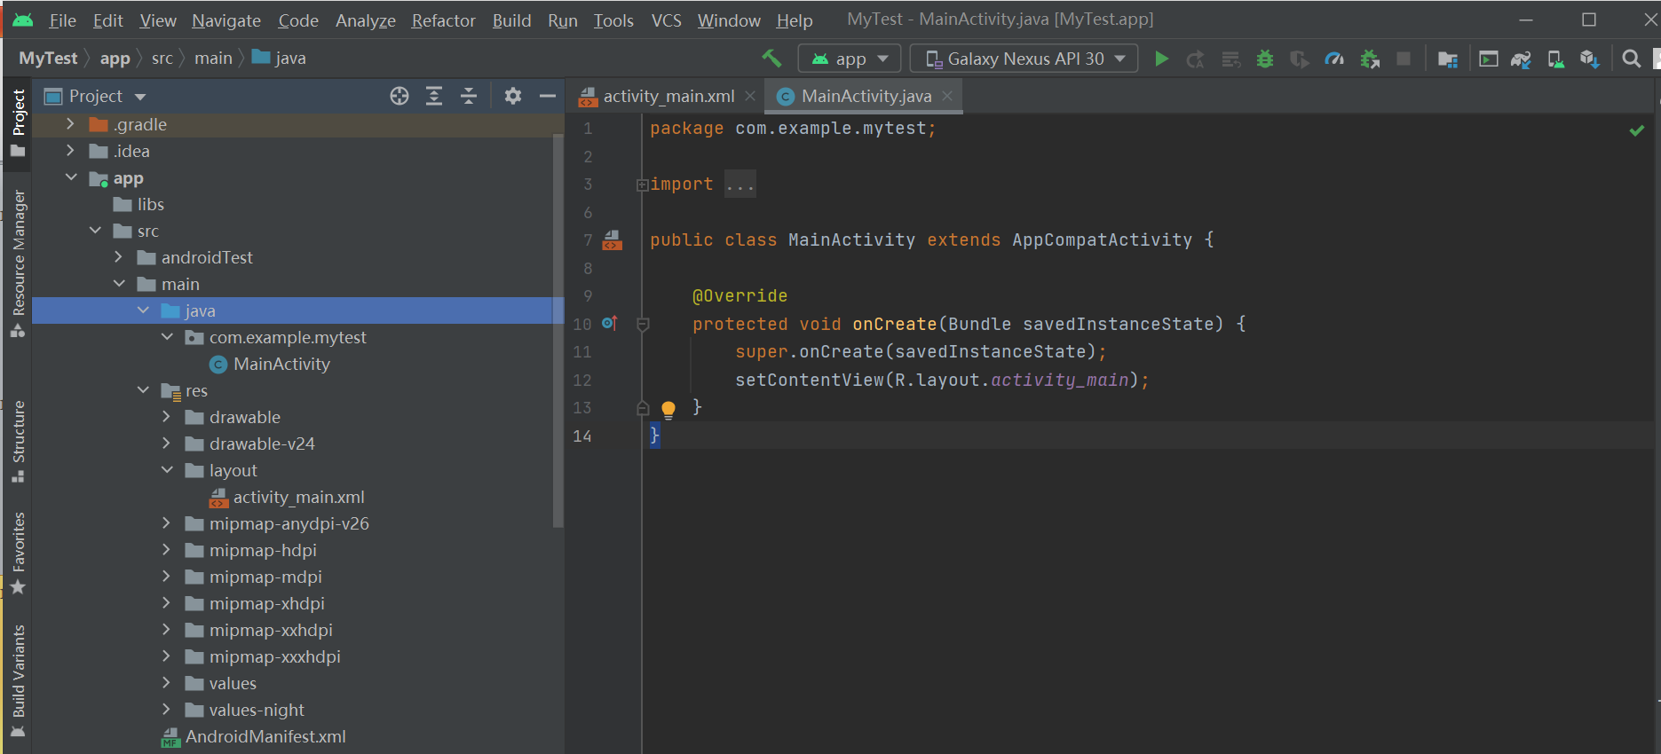
6) . Introduction to some important files

Slide 13
4. Introduction to Android Studio layout and common controls
Introduction to Android Studio Layout
LinearLayout (commonly used )
RelativeLayout (commonly used )
GridLayout (sometime used )
FrameLayout
Constrained layout
... …

Slide 14
4. Introduction to Android Studio layout and common controls
Introduction to commenly used Android Studio Views
TextView
EditView
Button
ImageView
ScrollView
ImageButton
RadioButton
CheckBox
… …

Slide 15
5. Course projects
Calculator App design
Music Player App design
Near Field Communication (NFC) App design
Mobile Phone Security Assistant App design
Shopping App design

Slide 16
6. Task
1) Please download the JDK and Android studio installation package from the Blackboard.
But you can follow the installation steps in the link below to finish the installation.
Note: Don’t download the JDK and Android studio software in the link below.
https://gitee.com/openatom-university/app-dev/blob/master/%E8%AF%BE%E4%BB%B6/02-Andriod%E5%BC%80%E5%8F%91%E8%AF%BE%E7%A8%8B/02-Android%E5%BA%94%E7%94%A8%E5%BC%80%E5%8F%91%E5%BF%AB%E9%80%9F%E5%85%A5%E9%97%A8.md
2）During the installation of Android studio, if the following windows pops up, follow the selection indicated by the red rectangles.

Slide 17
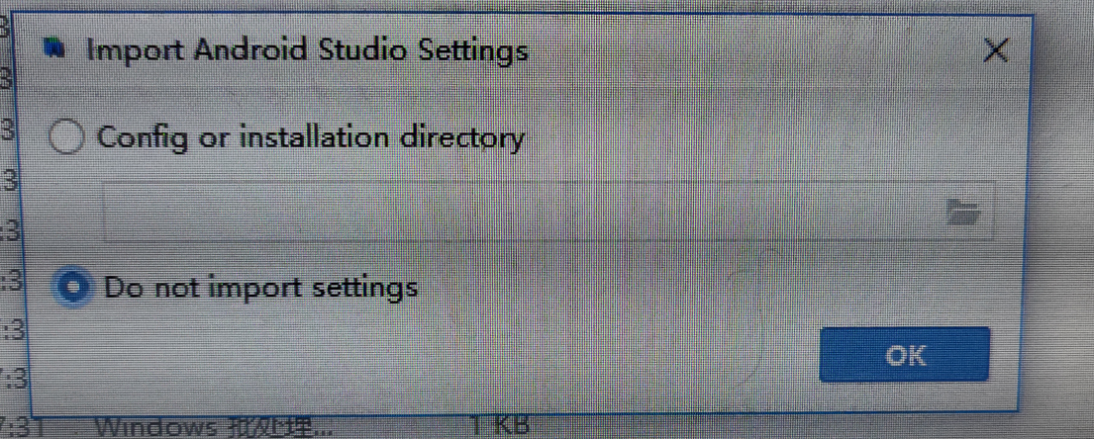
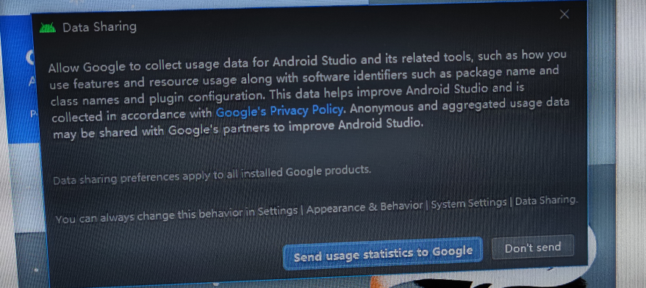

Slide 18
